Slide 1
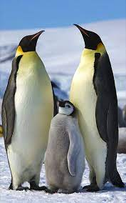
Project: Penguins
Based on the data we are going to predict the
sex of the penguins
Link: https://www.kaggle.com/mathchi/penguins-data-set
Data: Penguins Data

Slide 2
CHALLENGES IN THE PROJECT/DATA
The data was containing some missing values [Handling the Missing values]
The data was containing nonnumerical values so need to be converted in to numerical data where the machine learning model can understand
The data was not in the same range so need to be standardized
Some of the data was not Straight forward

Slide 3
Major Findings through EDA
The target variable has equal no of counts, it is equally balanced need not to be perform SMOTE operation
Bill depth and flipper length is negatively co-related
Flipper length and bill length are positively co-related
By seeing the distribution plot we can state that all the data are normally distributed looks like a bell shaped curve

Slide 4
My Learning
I Learnt how to handle the missing values
I Learnt hot to convert object datatype to int by doing some modifications
Learnt how to find the insights from the data by visualizing the plots
Learnt how to Perform Feature Extraction
Learnt how to Perform OneHotEncoding
Learnt how to Build Model by using different Classification Algorithum

Slide 5
Data Manipulation
Performed OneHodEncoding
Handling the missing values
converting the categorical value of Sex into numeric. We represent 0 as female and 1 as male
Performing the Standardization operation

Slide 6
Model
Logistic Regression
Support Vector Machines (SVC)
k-Nearest Neighbor (KNN)
Decision Tree
Random Forest

Slide 7
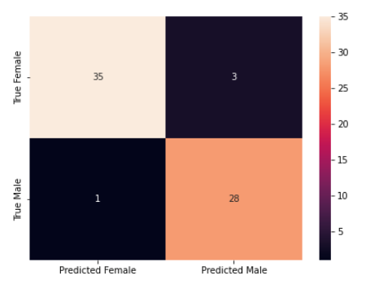
Building Model
Here I have Built the model using different algorithms as shown in the above slide
I am considering Random Forest Classifier because it is giving me the highest accuracy when compared to another model
You can see my confusion Matrix Out of 38 Female, it predicted 35 times correctly and 3 times it wrongly predicted
where for Male Out of 29,
28 times it predicted
Correctly and 1 times it predicted
wrongly

Slide 8
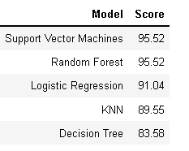
Comparison of Models
By seeing the table, we can say that
Supper Vector Machines and Random Forest classifiers
have the highest accuracy score.
Among these two, we choose the Random Forest classifier
To plot the ROC Curve

